Slide 1

Project Phase 1 - by team beta

Slide 2

AGENDA
INTRODUCTION
Data exploration
Pre-processing
Visualization
pipeline

Slide 3
This project focuses on building a sentiment analysis model for product reviews using Natural Language Processing (NLP) techniques. The goal is to analyze customer feedback and classify sentiments as positive, neutral, or negative using both Lexicon-based and Machine Learning-based approaches.
INTRODUCTION

Slide 4

In the data exploration phase, we analyzed the dataset’s structure and key attributes like reviewText and overall ratings. We inspected sample rows using df.head(), while df.info() helped detect missing values. df. describe () provided statistical insights, and df ["reviewText"] .apply (len). describe() revealed review length variations. We checked duplicates (df.duplicated().sum()) and identified outliers in review lengths to ensure data quality. These steps ensured a clean and structured dataset for sentiment analysis.

Slide 5
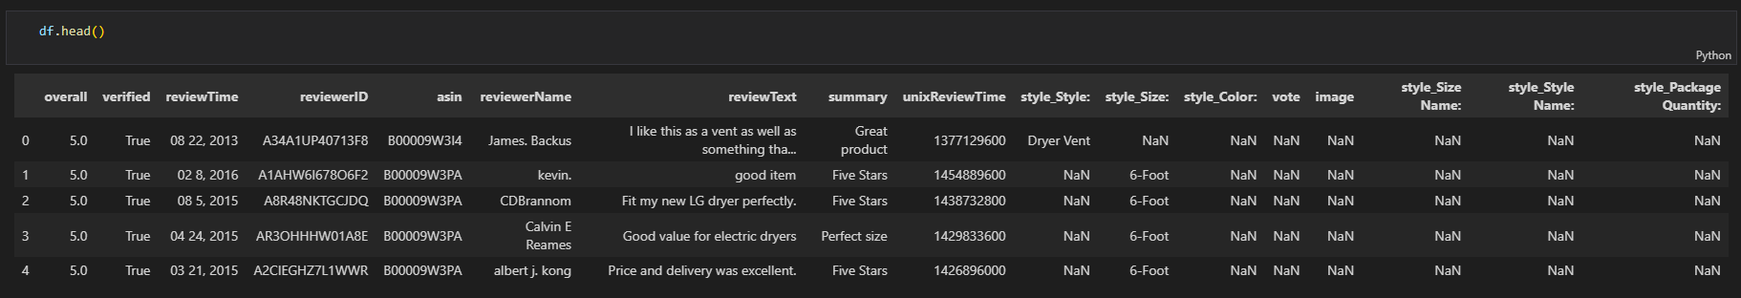
DATA EXPLORATION

Slide 6
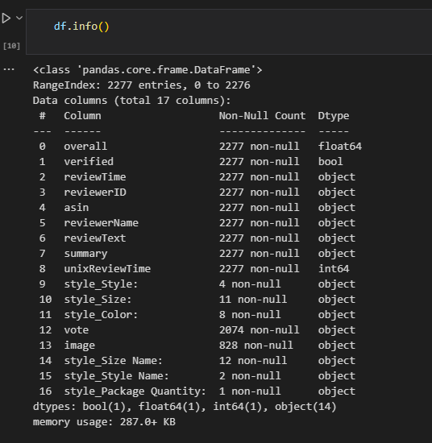
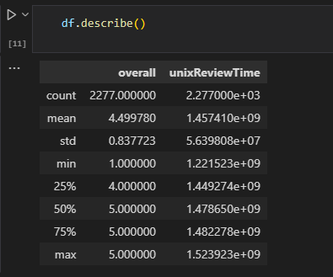
DATA EXPLORATION

Slide 7
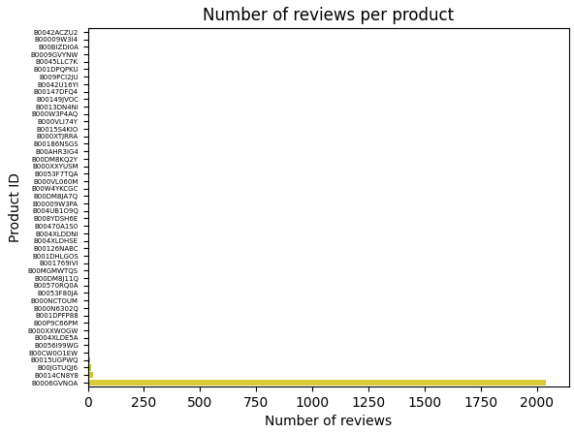
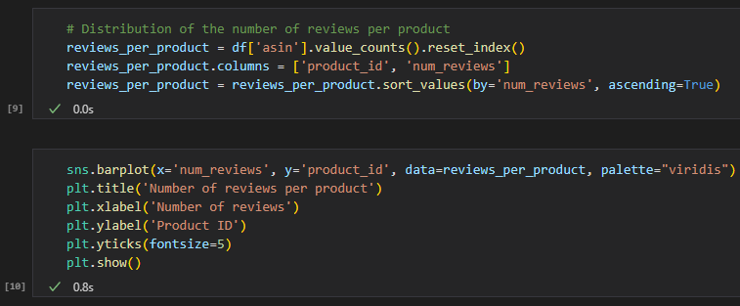
VISUALIZATION

Slide 8
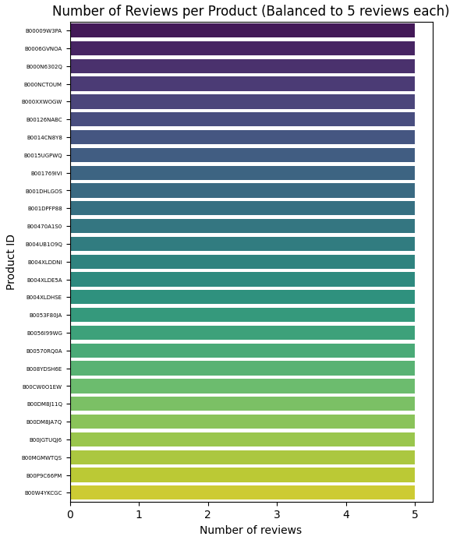
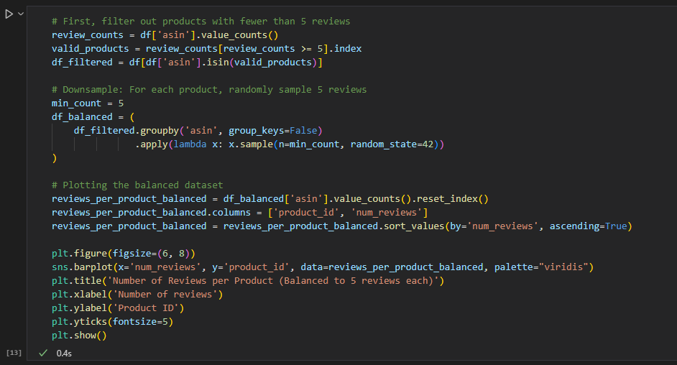
VISUALIZATION
Notes:
Explanation
Filtering Products:
We first calculate the number of reviews per product using value_counts() and then filter out products that have fewer than 5 reviews.
Downsampling:
We then group by asin and use .sample(n=5, random_state=42) to randomly pick 5 reviews for each product.
Plotting:
Finally, we recreate the bar plot to verify that each product in the balanced dataset now has exactly 5 reviews.
This approach ensures that your sentiment analysis dataset is balanced with 5 reviews per product.

Slide 9
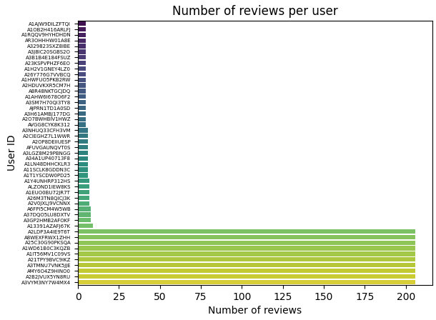
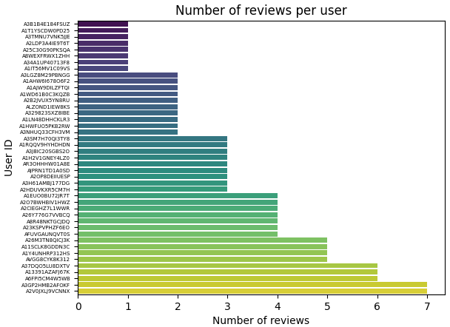
VISUALIZATION
Notes:
Right side uses the balanced dataset and is definitely better for sentiment analysis
More Even Distribution:
In the left (unbalanced) plot, some users have 200+ reviews, while most have far fewer. This can introduce bias, where certain users’ opinions dominate the model.
The right (balanced) plot ensures that no single user has an overwhelming number of reviews, making the dataset fairer.
Prevents Model Bias:
If a few users contribute most of the reviews, the sentiment model may overfit to their writing style and preferences.
A balanced dataset helps the model generalize better across different users.
Better Representation of General Users:
The right-side dataset ensures that reviews are not skewed by power users who leave many reviews. Instead, each user's sentiment contributes equally.

Slide 10
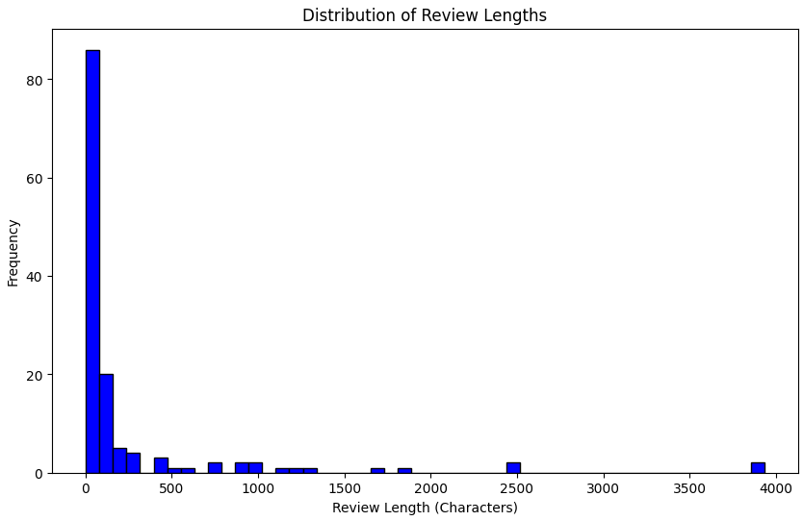
BASIC PRE-PROCESSING

Slide 11
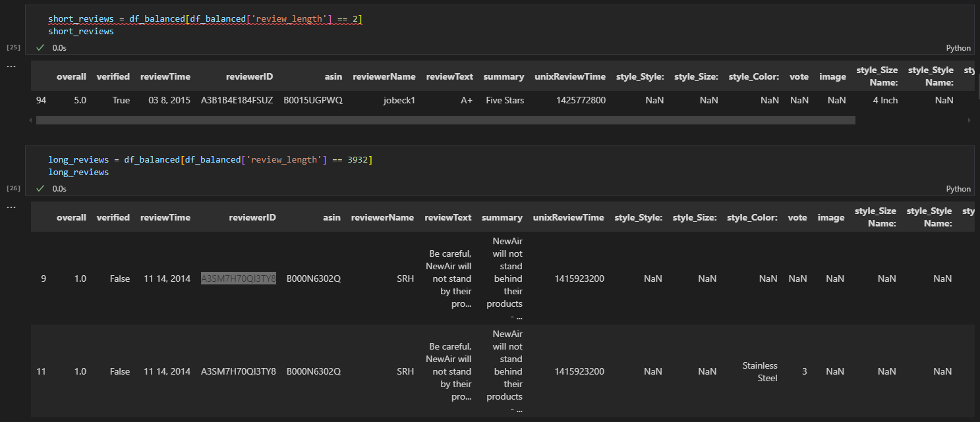
BASIC PRE-PROCESSING

Slide 12
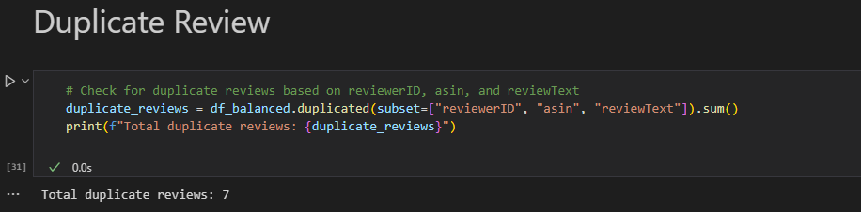
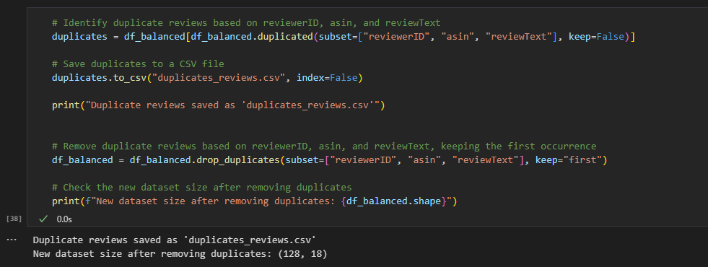
BASIC PRE-PROCESSING
Notes:
Why Remove Duplicate Reviews?
Avoid Overrepresentation of Certain Reviews
If a single review is duplicated multiple times, it can artificially skew sentiment analysis results by making certain sentiments appear more common than they actually are.
Prevent Model Bias
Machine learning models (especially sentiment classifiers) learn patterns from data.
Duplicate reviews could cause the model to give extra weight to repeated opinions, making it less generalizable.
Improve Dataset Quality
A cleaner dataset ensures that each review contributes uniquely, leading to more accurate sentiment predictions.

Slide 13
We cleaned the text by removing special characters, extra spaces, and punctuation in preprocessing. All text was converted to lowercase for consistency and then tokenized into individual words using word_tokenize(). Stopwords like the, is, and were removed, and words were standardized using stemming and lemmatization. Finally, we handled missing values by removing or replacing incomplete reviews. These steps ensured a clean dataset for accurate sentiment analysis.

Slide 14
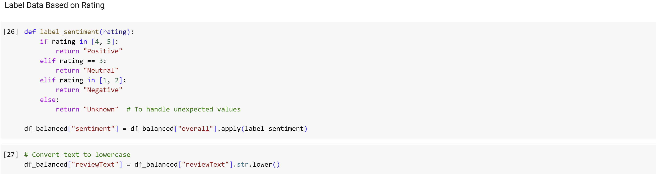
BASIC PRE-PROCESSING

Slide 15
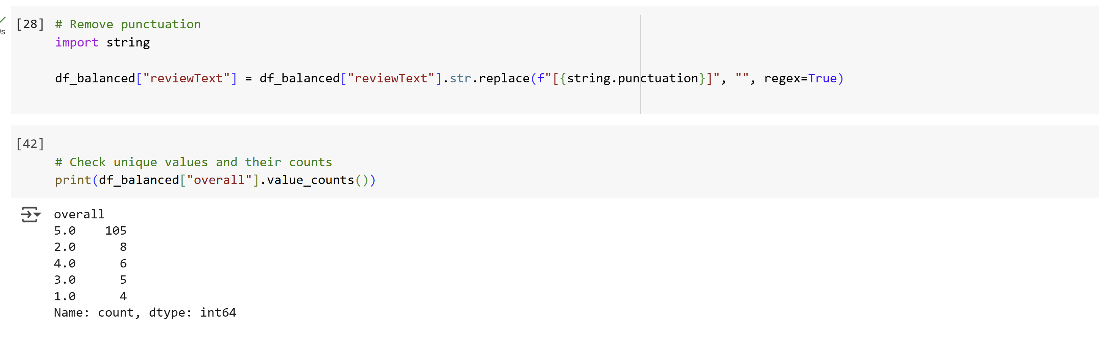
BASIC PRE-PROCESSING

Slide 16
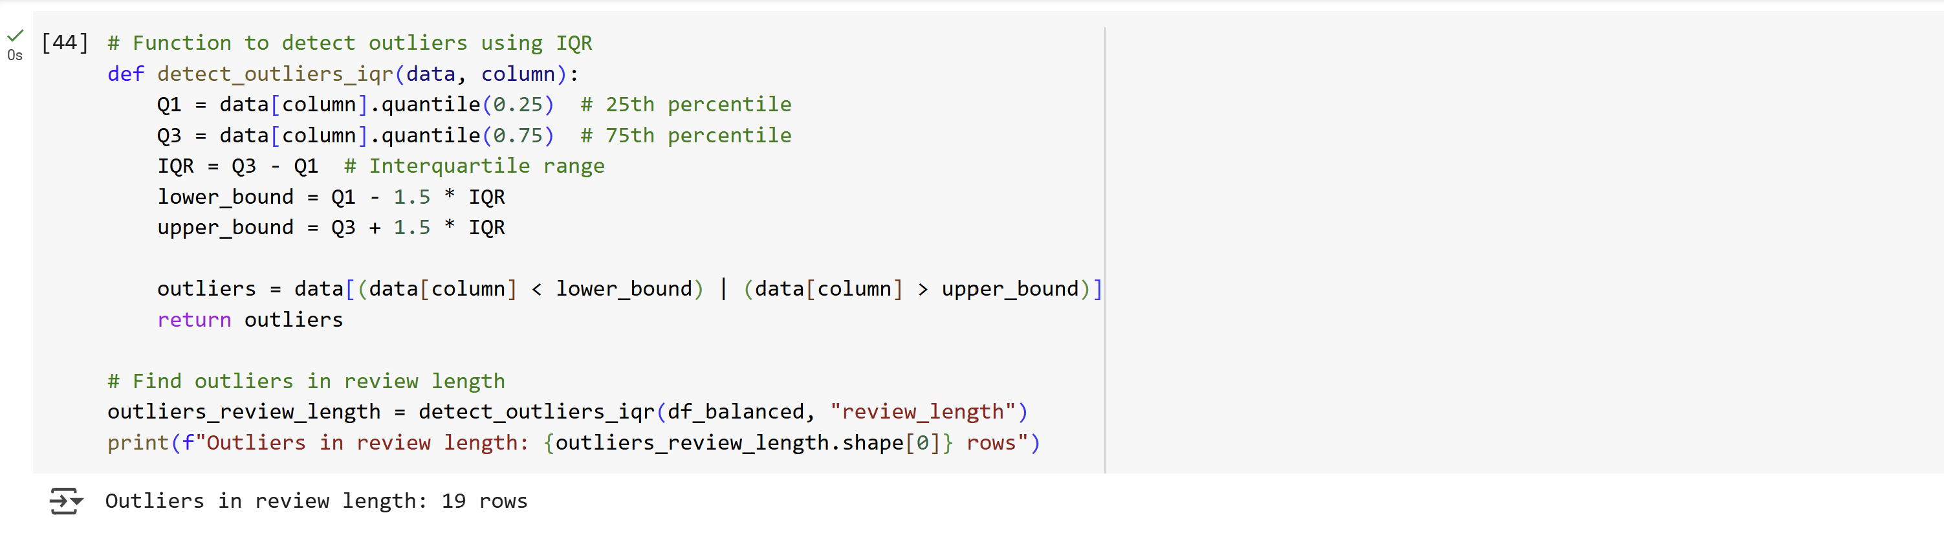
BASIC PRE-PROCESSING

Slide 17
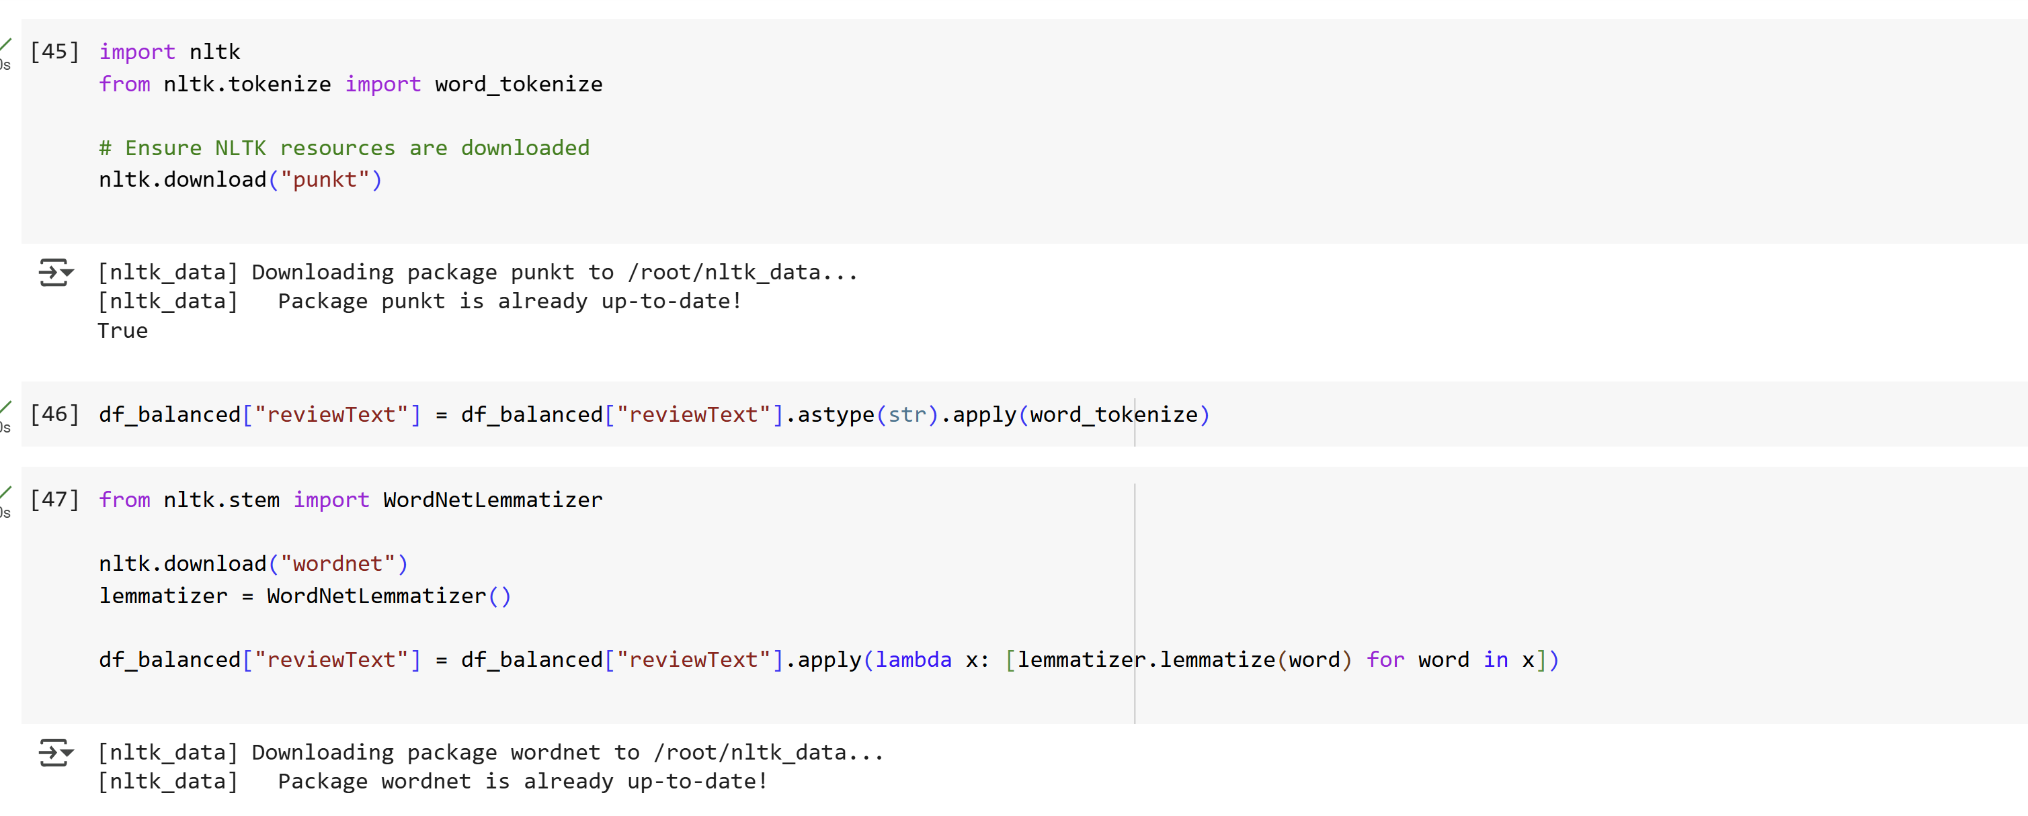
BASIC PRE-PROCESSING

Slide 18
We visualized review distributions to analyze how reviews vary across different products and categories, helping identify trends in customer feedback. By plotting sentiment categories, we observed the proportion of positive, neutral, and negative reviews, providing insights into overall customer sentiment. Additionally, we examined review length distributions and outliers to understand variations in textual data. These visualizations helped us interpret patterns in the dataset, detect anomalies, and refine our sentiment analysis approach..

Slide 19
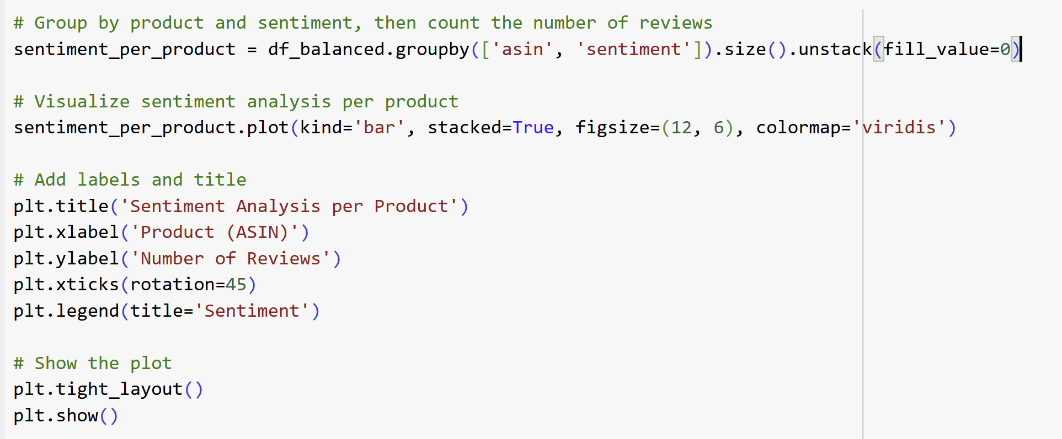
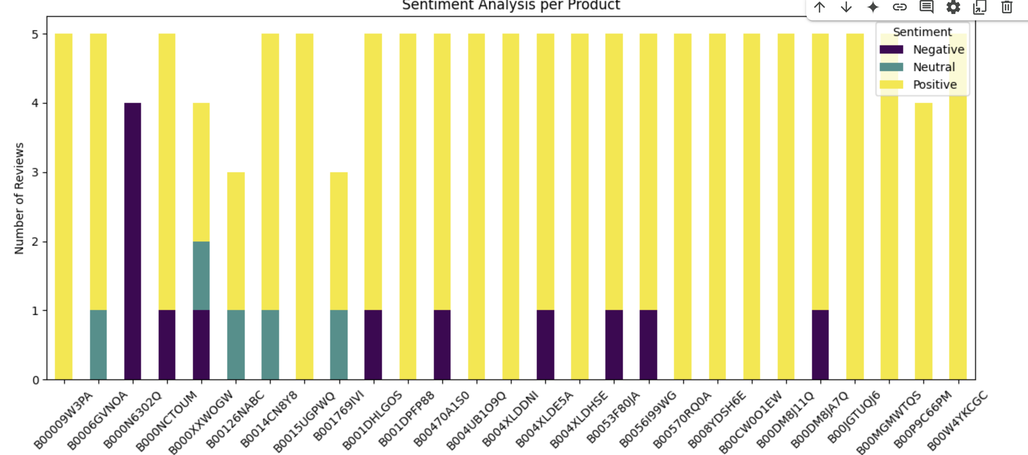

Slide 20
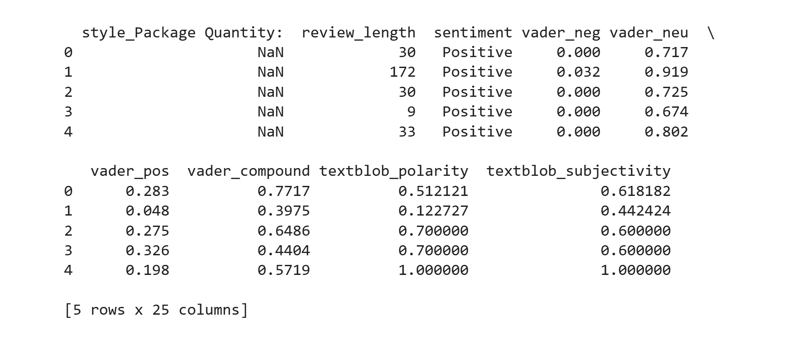
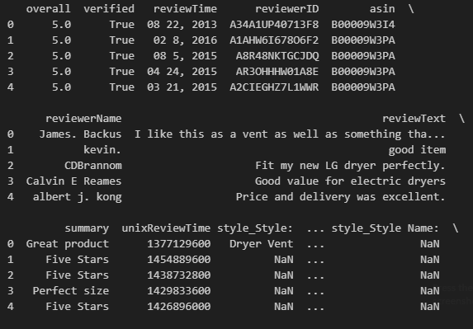
result

Slide 21
Sentiment Lexicons
VADER & TextBlob were chosen for sentiment analysis due to:
VADER’s strengths:
Built for short, informal reviews (handles slang, emojis, abbreviations).
Uses context-aware rules (negations, intensifiers) for precise intensity scores.
Performs better after outlier removal (cleaned data focuses on concise text).
TextBlob’s advantages:
Simple integration and polarity/subjectivity scores to filter objective reviews.
Complements VADER for broader sentiment insights without added complexity.
SentiWordNet was excluded because:
Relies on WordNet synsets, unsuitable for informal language.
Lacks context sensitivity for slang/emojis.

Slide 22
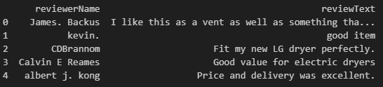
Review Text (row 0 -4)

Slide 23
Metric | VADER (Lexicon-Based) | TextBlob (Lexicon-Based) | Example (Row 0) | Example (Row 1) | Example (Row 2) | Example (Row 3) | Example (Row 4)
Negative Score | vader_neg | N/A | 0.0 | 0.0 | 0.0 | 0.0 | 0.0
Neutral Score | vader_neu | N/A | 0.720 | 0.256 | 0.374 | 0.361 | 0.519
Positive Score | vader_pos | N/A | 0.280 | 0.744 | 0.626 | 0.639 | 0.481
Compound Score | vader_compound | N/A | 0.8720 | 0.4404 | 0.7717 | 0.6486 | 0.5719
Polarity Score | N/A | textblob_subjectivity | 0.400 | 0.700 | 0.5121 | 0.700 | 1.0000
Subjectivity Score | N/A | textblob_subjectivity | 0.4375 | 0.6000 | 0.6182 | 0.6000 | 1.0000

Slide 24
Results Interpretation
The VADER compound score averages 0.4855,
indicating overall positivity,
while VADER and TextBlob agree 79.8% of the time.
Overall, VADER detects stronger sentiment shifts, while TextBlob tends to be milder in sentiment assignment.

Slide 25

THANK YOU
TEAM BETA

